Slide 1
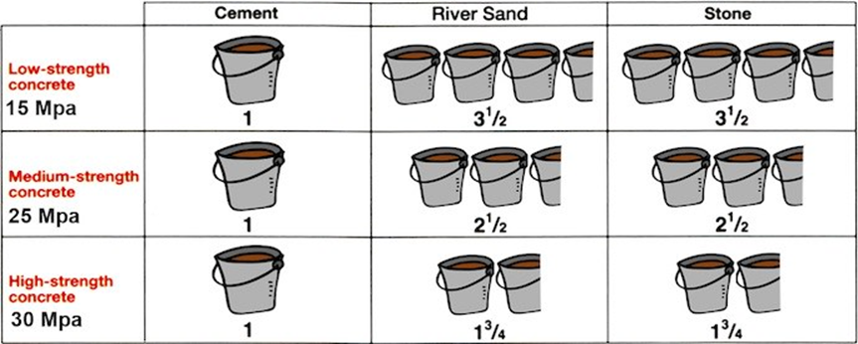
Mixing Ratio
When using a bucket

Slide 2
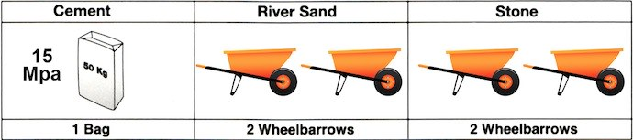
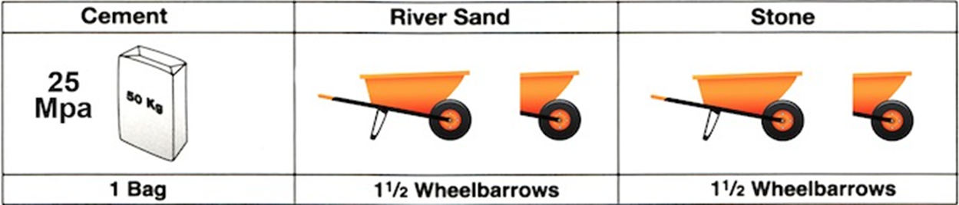
When using a wheelbarrow
Low strength concrete mix
Medium strength Concrete Mix

Slide 3

Mixing ratios( continues)
Medium strength Concrete Mix
High strength Concrete mix
Feedback
Activity : Worksheet 4

Slide 4
Kwa Thema Skills School
Subject : Maintenance Marks: 12
Grade : Year 2 Time : 30mins
Date :
Question :

Slide 5
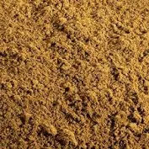
Question:2
1.Identify the following building and plastering materials.
1.____________________ 2.______________________
3.___________________ 4. ______________________
5. ______________________ 6. ______________________

Slide 6
Question:2
1.____________________ 2.______________________
3.___________________ 4. ______________________
5. ______________________ 6. ______________________

